Slide 1
[Analyzing Study Abroad Costs]
[Chhaileng Tim]
Subject : Data with Python
Trainer : Bonpagna KANN
1

Slide 2
Content
Dataset Description
Data Preprocessing
Research Questions
Methods
Results and Discussion
Conclusions
2

Slide 3
1. Dataset description
This dataset contains information on 907 university programs across multiple
countries and cities
This dataset have 907 rows and 12 columns including:
Country, City, University, Program, Level, Duration_Years, Tuition_USD, Rent_USD, Visa_Fee_USD, Insurance_USD, Exchange_Rate
Each row = 1 international university program
Used for analyzing education costs globally
3

Slide 4

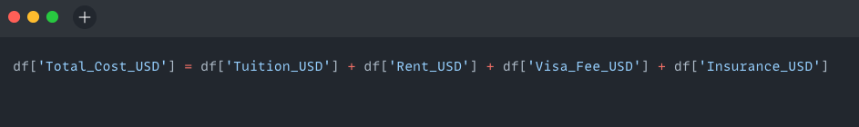
2. Data Preprocessing
In order to perform data analysis and extract useful insights from the dataset, I followed these preprocessing steps:
Process 1 : Created Total_Cost_USD column
I combined Tuition_USD, Rent_USD, Visa_Fee_USD, and Insurance_USD to calculate the total cost for each international university program.
4

Slide 5
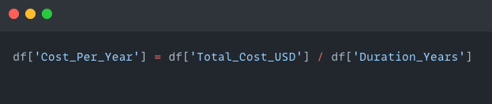
2. Data Preprocessing
Process 2 : Calculated Cost_Per_Year
To fairly compare programs of different durations, I created a column that divides the total cost by the number of study years.
5

Slide 6

3. Research Questions
The goal of this project is to explore the cost of studying abroad using a dataset of 907 international university programs. The following research questions guide the analysis:
Research Question 1
Which countries are the most expensive for international students? ➡️ Focus: Total tuition + living-related costs
2. Research Question 2
How does the average total cost compare by program level (Bachelor’s, Master’s, PhD)?
➡️ Focus: Understanding how education level affects cost
6

Slide 7
3. Research Questions
3. Research Question 3
Which cities offer the most affordable study options?
➡️ Focus: Identifying cost-effective study locations
4. Research Question 4
Which countries offer the most university programs for international students?
➡️ Focus: Counting program availability per country
5. Research Question 5
Which country provides the best value in terms of cost per study year?
➡️ Focus: Normalizing total cost by program duration to find best value
7

Slide 8

4. Methods - Question 1
[Explanation about process to answer Question 1]
Group by : Country
Data aggregation : average Total_Cost_USD
Sort data : descending by Avg_Total_Cost
Build graph : select Country and Avg_Total_Cost
8

Slide 9
4. Methods - Question 2
[Explanation about process to answer Question 2]
Group by : Level
Data aggregation : average Total_Cost_USD
Sort data : descending by Avg_Total_Cost
Build graph : select Level and Avg_Total_Cost
9

Slide 10
4. Methods - Question 3
[Explanation about process to answer Question 3]
Group by : City
Data aggregation : average Total_Cost_USD
Sort data : ascending by Avg_Total_Cost
Build graph : select City and Avg_Total_Cost
10

Slide 11
4. Methods - Question 4
[Explanation about process to answer Question 4]
Group by : Country
Data aggregation : count number of Program
Sort data : descending by number of programs
Build graph : select Country and Program count
11

Slide 12
4. Methods - Question 5
[Explanation about process to answer Question 5]
Create column : Cost_Per_Year = Total_Cost_USD / Duration_Years
Group by : Country
Data aggregation : average Cost_Per_Year
Sort data : ascending by Avg_Cost_Per_Year
Build graph : select Country and Avg_Cost_Per_Year
12

Slide 13
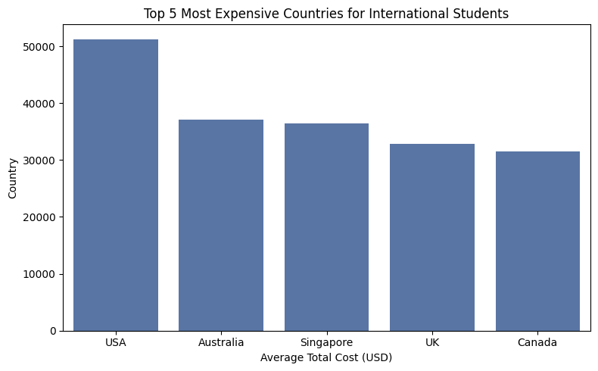
5. Findings - Question 1
Research Question: Which countries are the most expensive for international students?
Calculated total cost by combining tuition, rent, visa fee, and insurance
Grouped data by country and calculated average total cost
Sorted countries by highest average cost
📈 Key Insight
The top 5 most expensive countries for international
students based on average total cost are:
🇺🇸 United States
🇦🇺 Australia
🇸🇬 Singapore
🇬🇧 United Kingdom
🇨🇦 Canada
13
Notes:
EDA = Exploratory Data Analysis

Slide 14
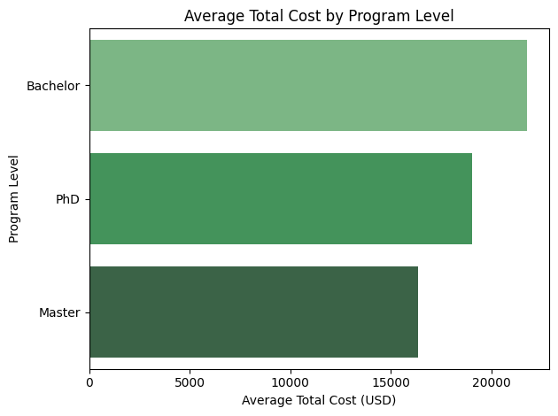
5. Findings - Question 2
Research Question: How does the average total cost compare by program level (Bachelor’s, Master’s, PhD)?
Calculated a Total_Cost_USD column (tuition + rent + visa + insurance)
Grouped the data by Level
Aggregated the mean total cost per level
Sorted to identify the most and least expensive levels
📈 Key Insight
On average, Bachelor’s programs are the most expensive,
followed by PhD, then Master’s programs.
14
Notes:
EDA = Exploratory Data Analysis

Slide 15
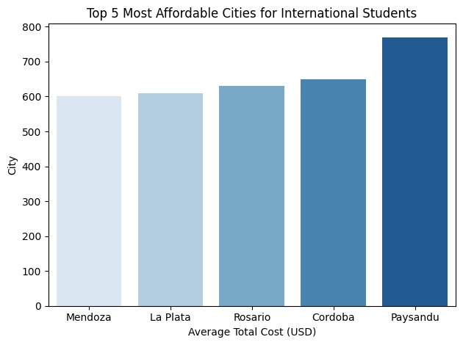
5. Findings - Question 3
Research Question: Which cities offer the most affordable study options?
Grouped the dataset by City Calculated the average Total_Cost_USD
for each city Sorted to find cities with the lowest average total costs
Focused on the top 5 most affordable cities
📈 Key Insight
The cities with the lowest average study costs
offer total affordability in both tuition and living expenses.
15
Notes:
EDA = Exploratory Data Analysis

Slide 16
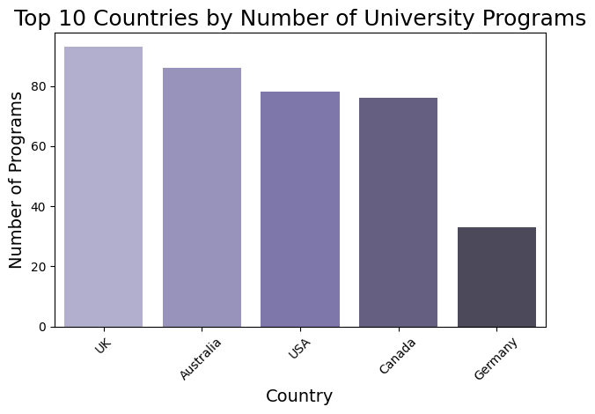
5. Findings - Question 4
Research Question: Which countries offer the most university programs for international students?
Grouped the data by Country
Counted the number of Program entries per country
Sorted countries by program count in descending order
Focused on the top 5 countries offering the widest program
selection
📈 Key Insight
The countries with the most international programs
provide the greatest variety and flexibility for students.
16
Notes:
EDA = Exploratory Data Analysis

Slide 17
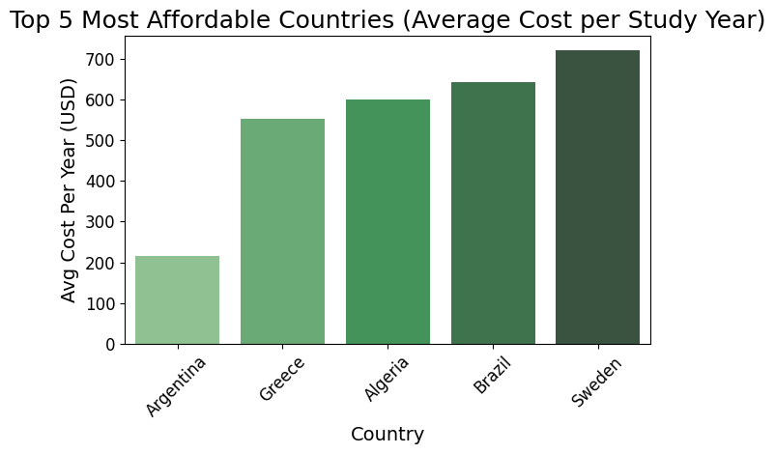
5. Findings - Question 5
Research Question: Which country provides the best value in cost per study year?
Created a new column: Cost_Per_Year = Total_Cost_USD / Duration_Years
Grouped data by Country
Aggregated the average cost per study year
Sorted results to find countries offering lowest yearly
study costs
📈 Key Insight
Some countries offer better value per year,
especially where total cost is low and duration is longer.
17
Notes:
EDA = Exploratory Data Analysis

Slide 18
6. Conclusion
The goal of this project was to analyze the costs of studying abroad using real data from 907 international university programs, and answer questions related to affordability, program variety, and value per study year.
18

Slide 19
🔍 Key Findings Summary
🌍 Most Expensive Countries: The USA, Australia, Singapore, UK, Canada, and have the highest average total costs for international students.
🎓 Program Cost by Level: Bachelor’s programs are the most expensive overall, likely due to their longer durations.
🌆 Affordable Cities: Some cities offer surprisingly low total study costs, making them ideal for budget-conscious students.
📚 Program Variety: Countries like the USA and UK offer the most international programs, giving students more choices.
💰 Best Value per Year: Countries with longer durations and lower annual expenses provide the best value for money.
🧠 Studying abroad can vary widely in cost depending on the country, city, and program level. This analysis helps students make informed decisions based on both budget and academic goals.
19

Slide 20
Thanks you!
20

